Slide 1
LHC-300 MECHANICAL
LIGHT ASSEMBLY INSTRUCTIONS
OpenAg, MIT Media Lab
By Eugene Zeleny
May 6th, 2019

Slide 2
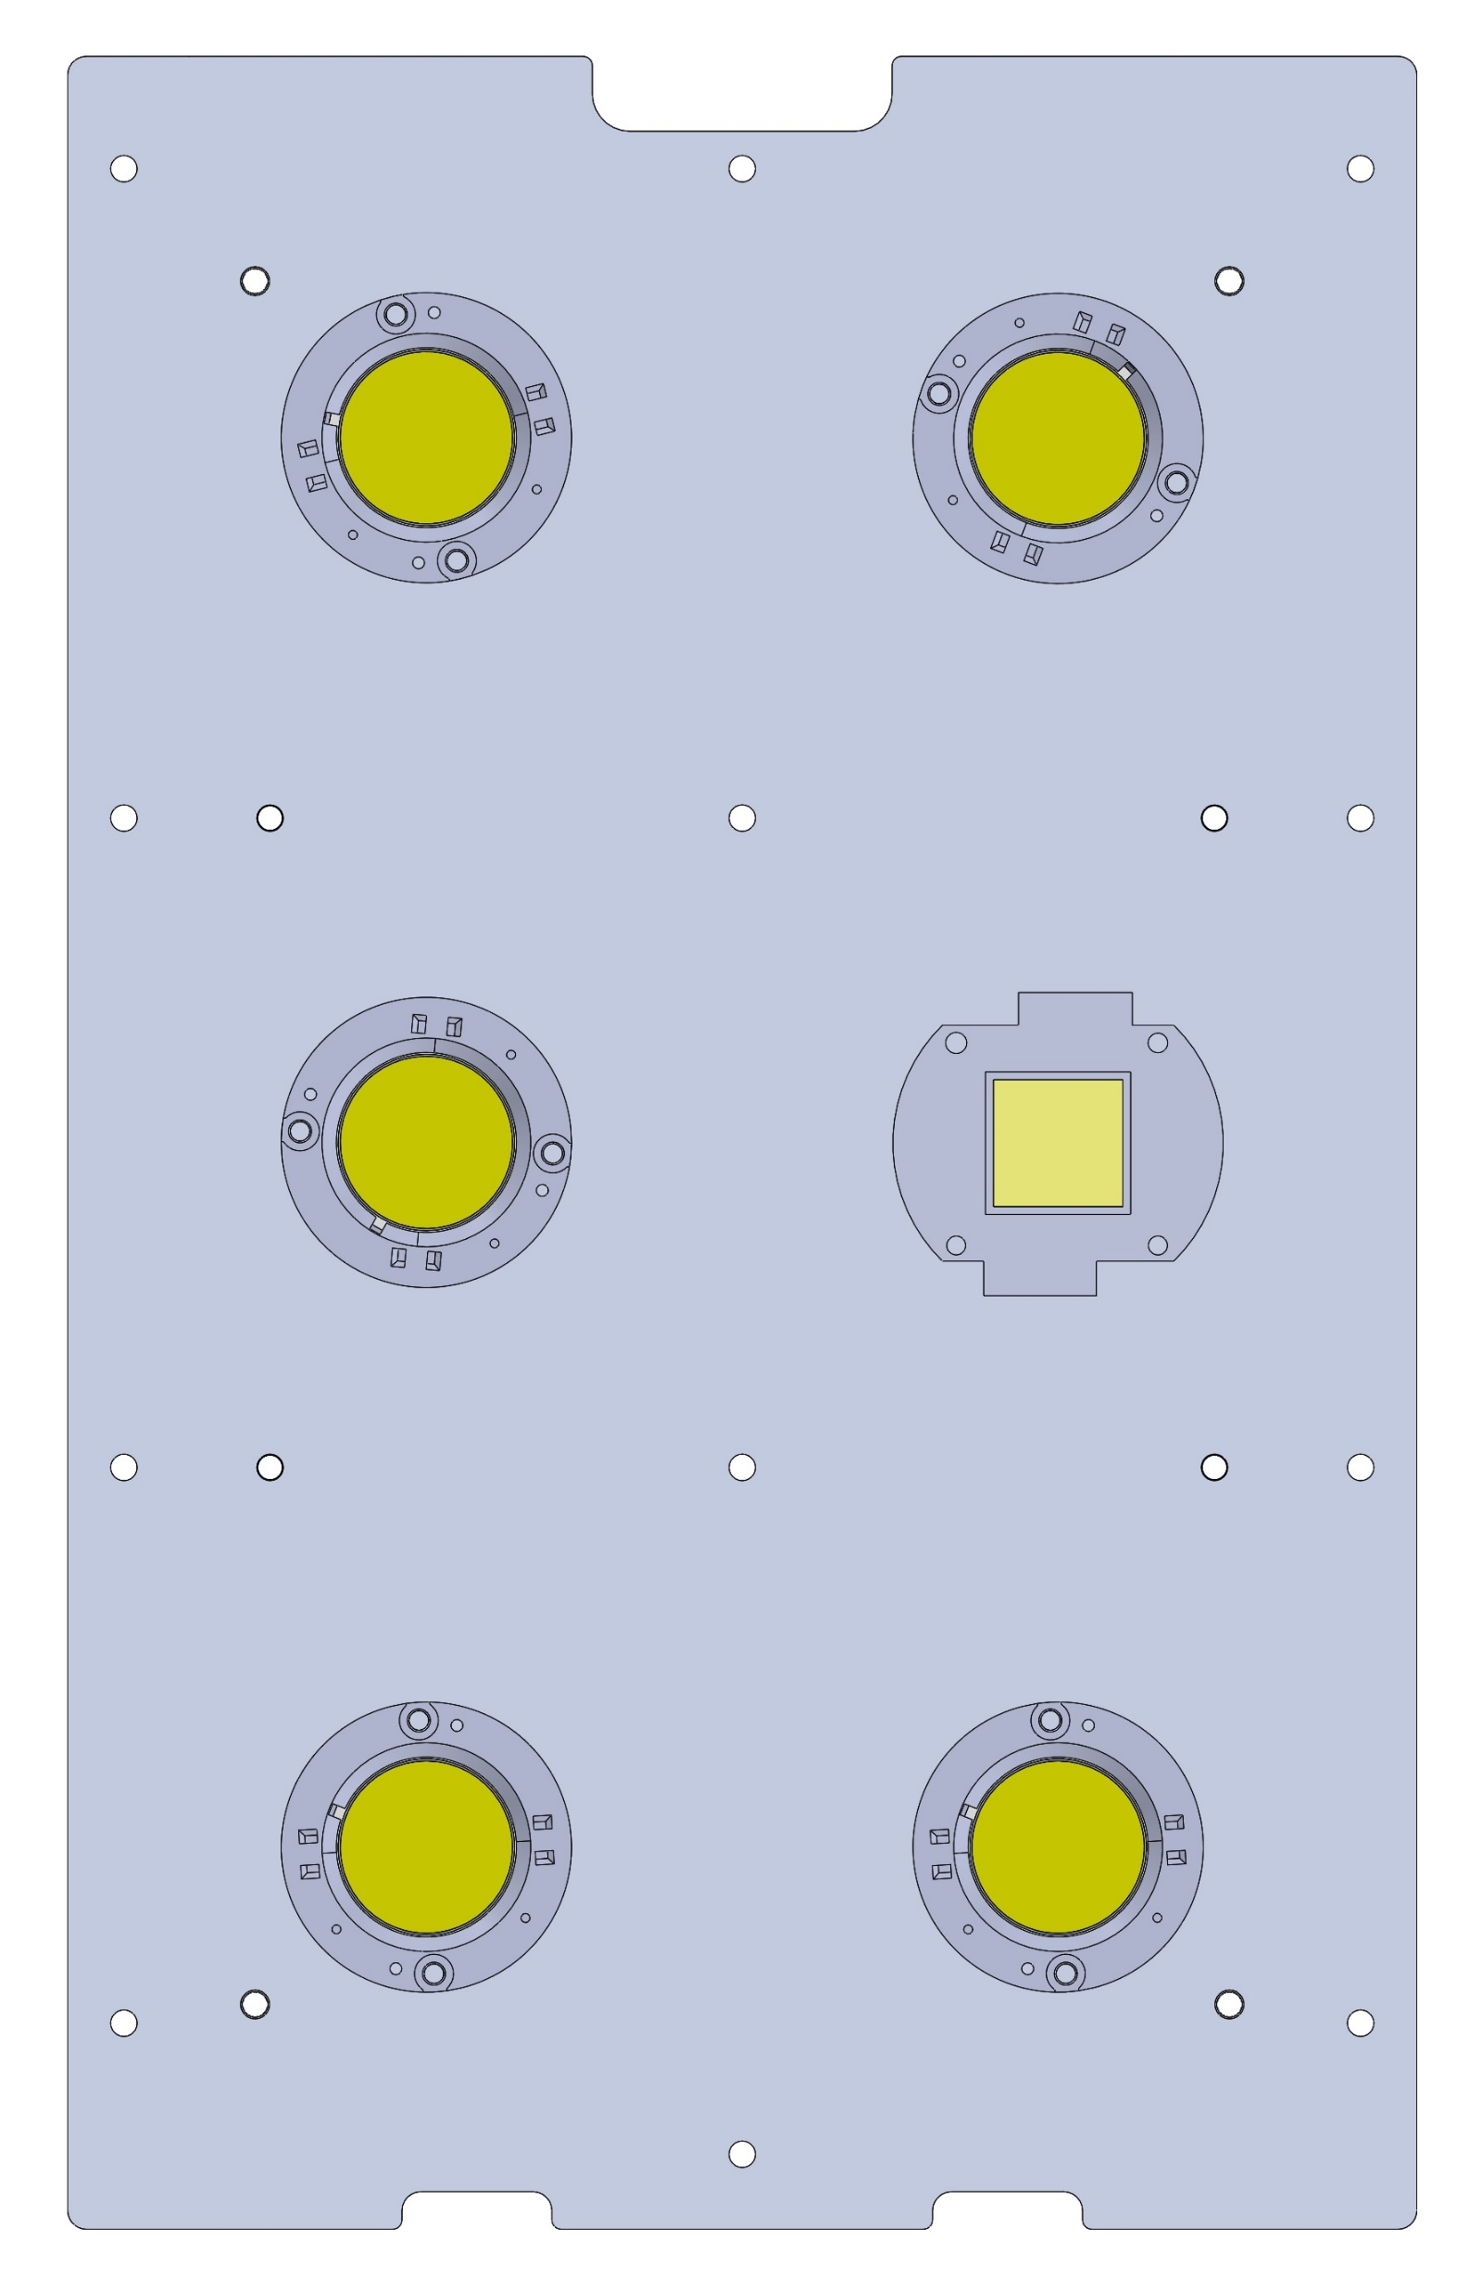
WIRES OUT
YELLOW
ORANGE
YELLOW
ORANGE FOR __ UNITS
RED FOR ___ UNITS
ORANGE
YELLOW
Attach the LEDs in place on the aluminum plate using the acrylic LED alignment fixture
Attach wires to LEDs, tape them down to aluminum plate so that the wires come out the “WIRES OUT” end of the plate

Slide 3
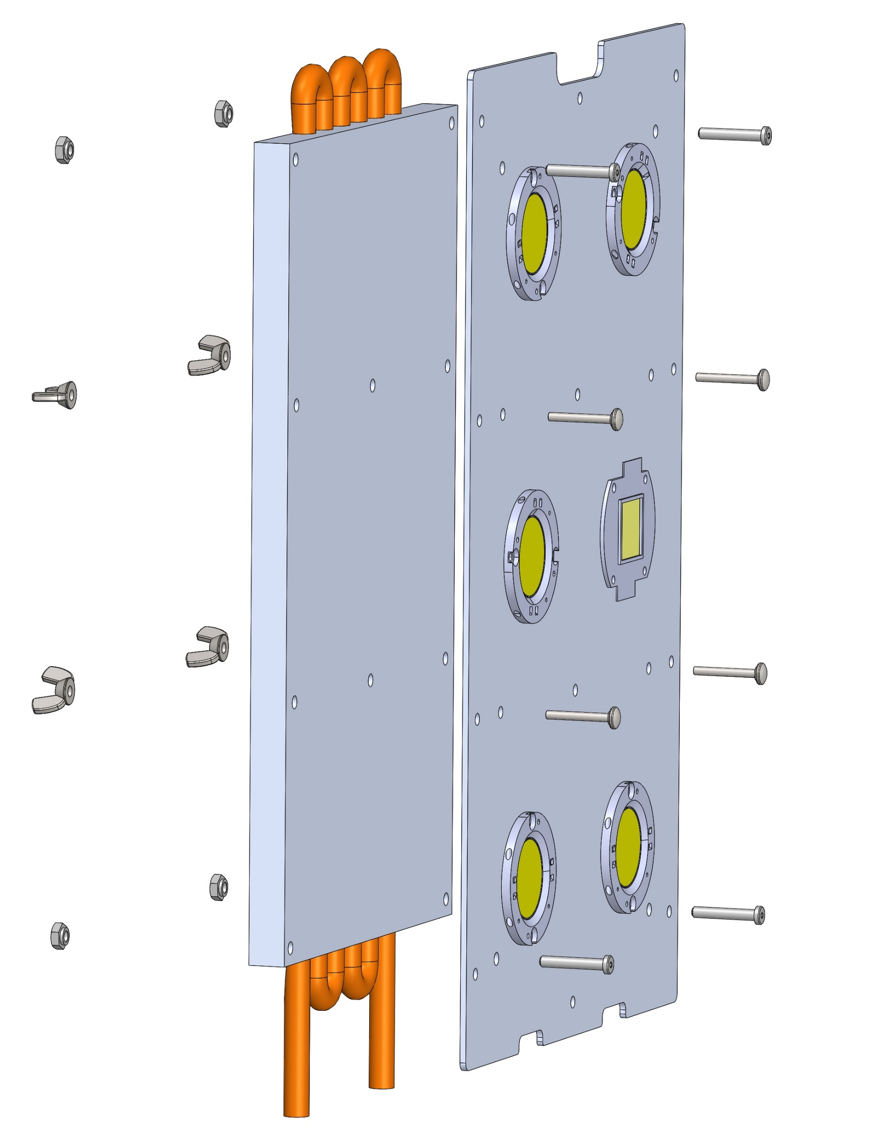
8-32 LOCK NUT #96278A009
8-32 LOW PROF. HEAD 1” LONG #90665A115
8-32 WING NUT #90866A009
8-32 PAN HEAD PHILLIPS 1” LONG #95345A554
Apply thermal grease to mating surface of heat sink
Attach heat sink to aluminum plate with indicated hardware

Slide 4
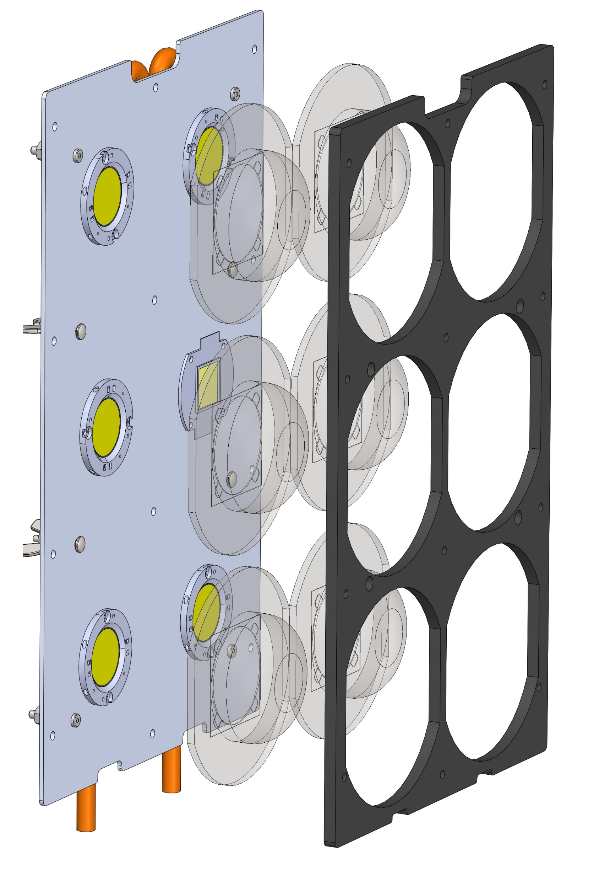
Position clear optics over each LED and position foam gasket over the optics, using the notched indicators for alignment

Slide 5
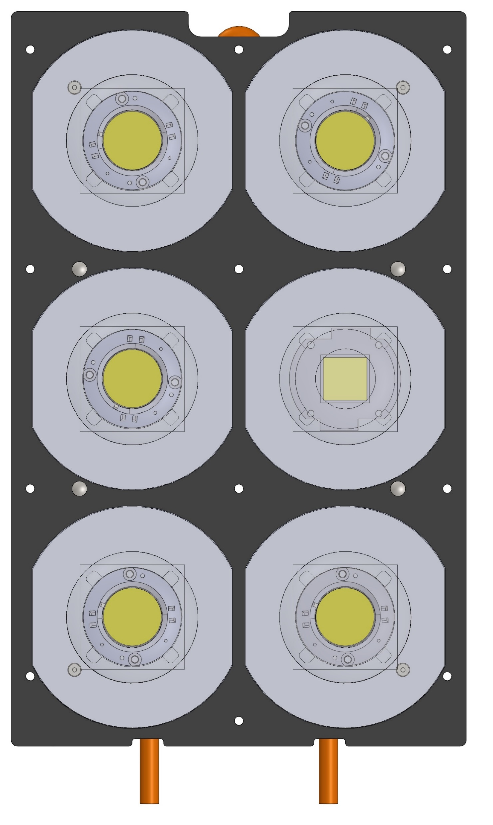
This is what the assembly should look like at this point

Slide 6
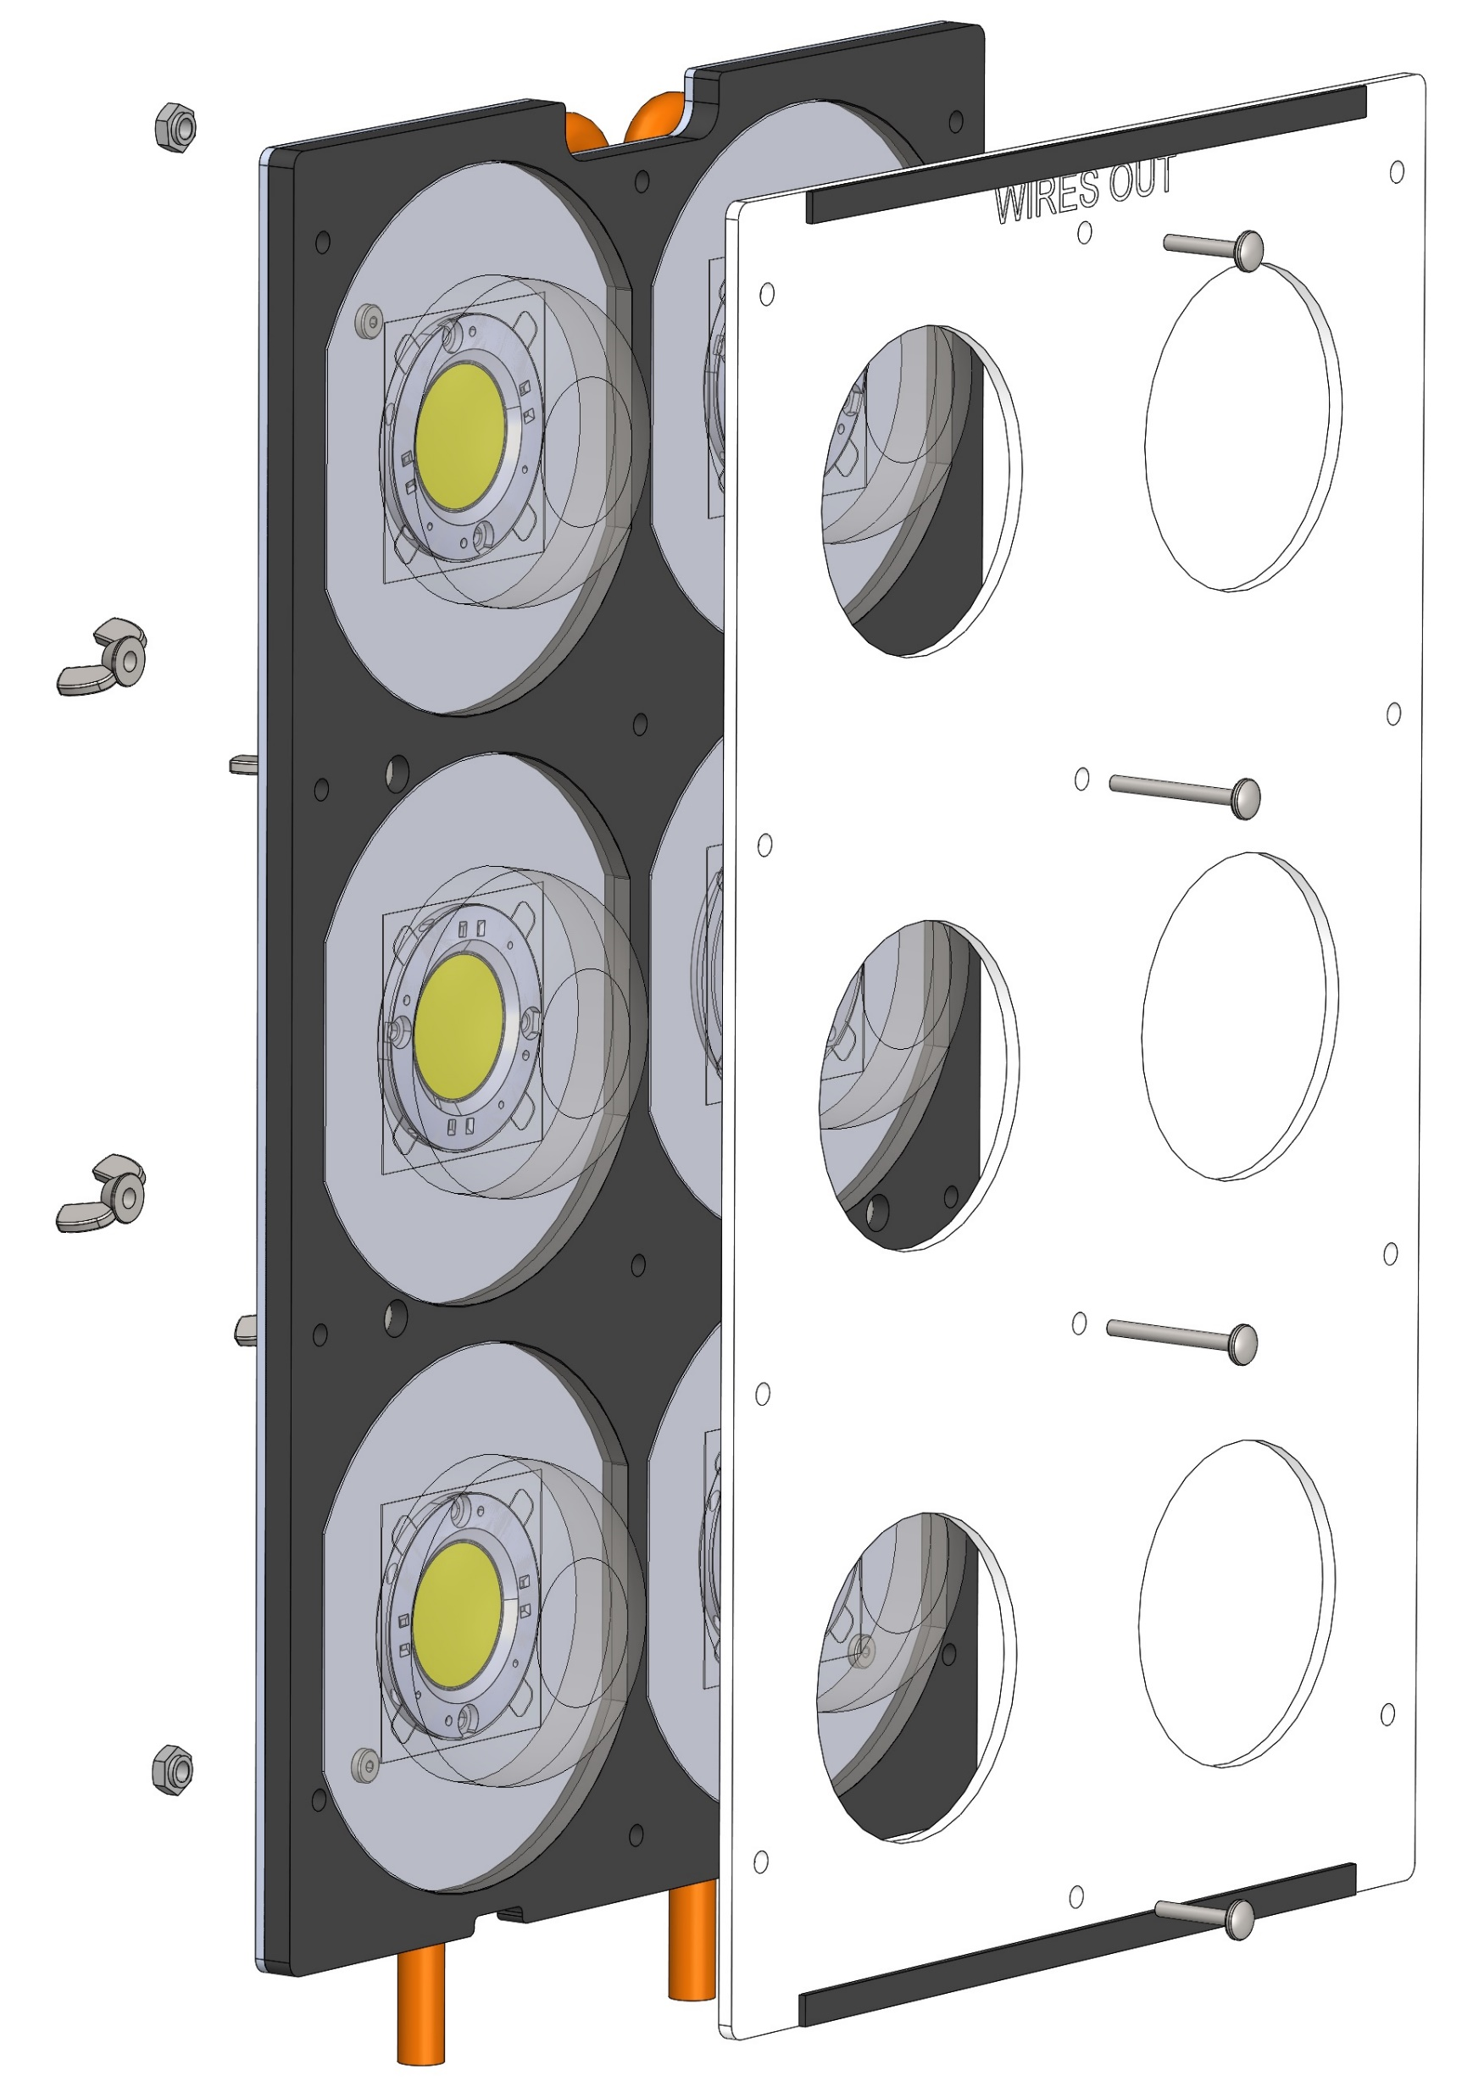
8-32 LOCK NUT #96278A009
8-32 PAN
HEAD PHILLIPS
¾” LONG #95345A548
8-32 PAN HEAD PHILLIPS 1.25” LONG #95345A555
8-32 WING NUT #90866A009
¼” WIDE, 1/16” THICK FOAM,
7.25” LONG #8694K111
Attach 1/16th foam strip as shown, centered on plastic cover plate
Attach plastic cover plate to assembly with indicated hardware

Slide 7
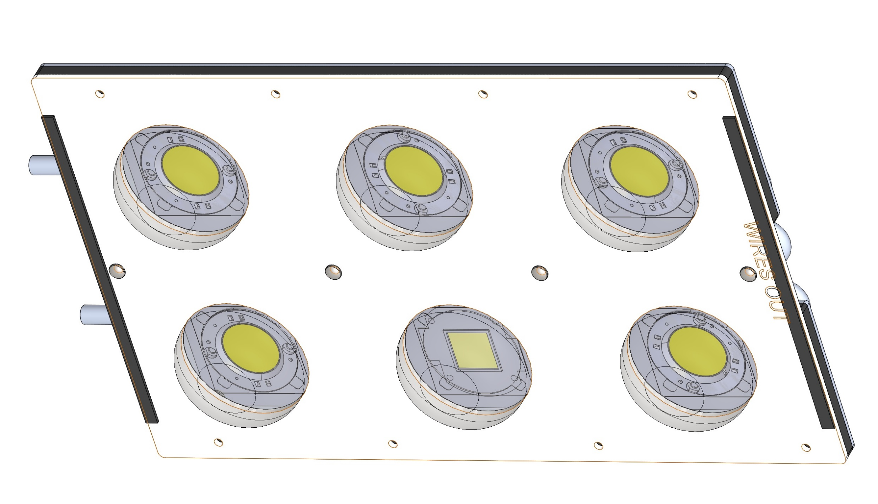
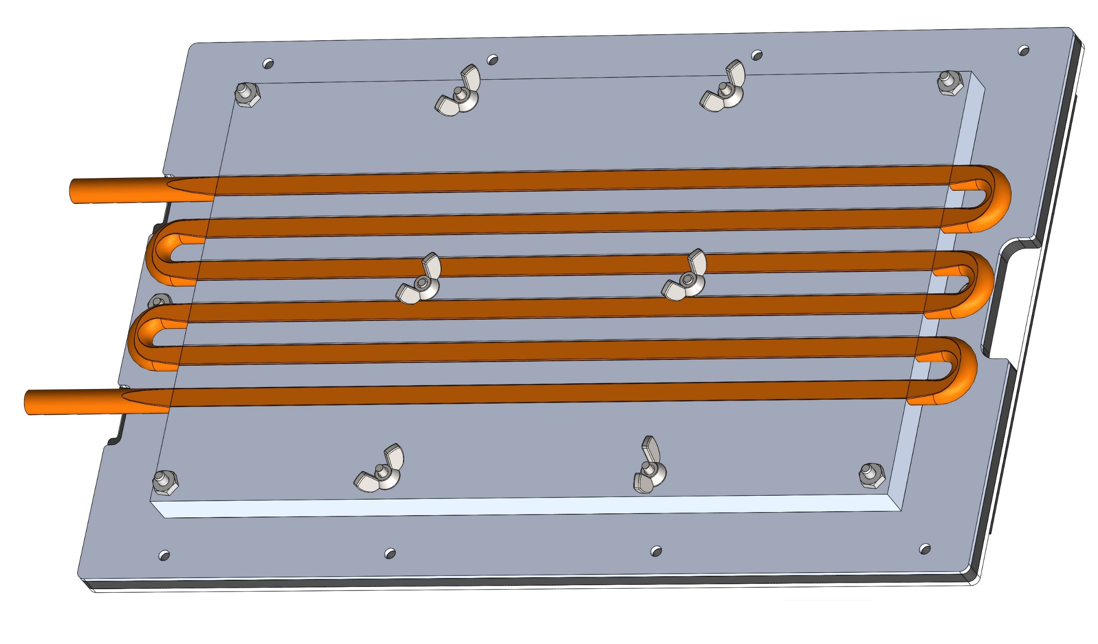
This is what the assembly should look like at this point

Slide 8
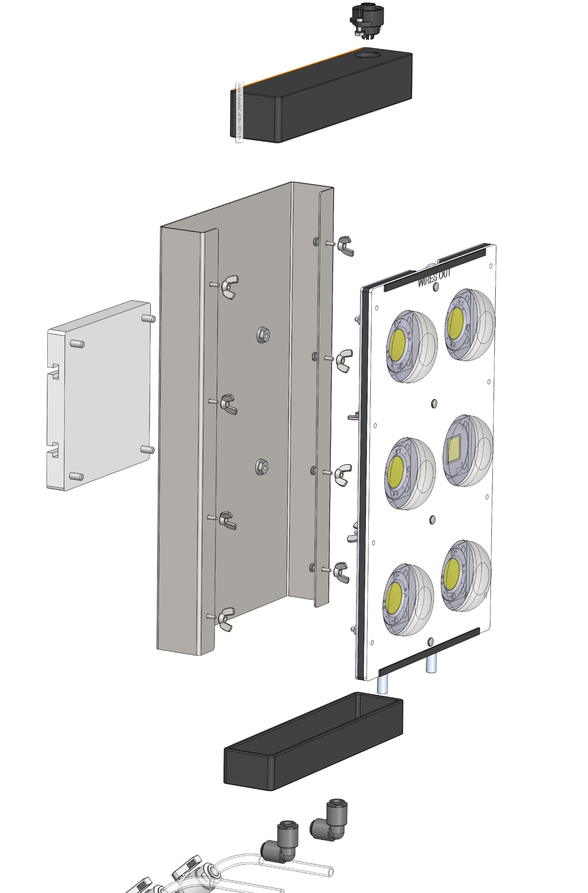
¼-20 FLANGED LOCK NUT #93776A421
8-32 PAN
HEAD PHILLIPS
¾” LONG #95345A548
¼-20 BOLT #92196A541
8-32 WING NUT #90866A009
Attach the Mounting Arm Adapter Plate to the sheet metal enclosure with the indicated hardware.
Attach the light assembly “sandwich” to the sheet metal enclosure with the indicated hardware

Slide 9
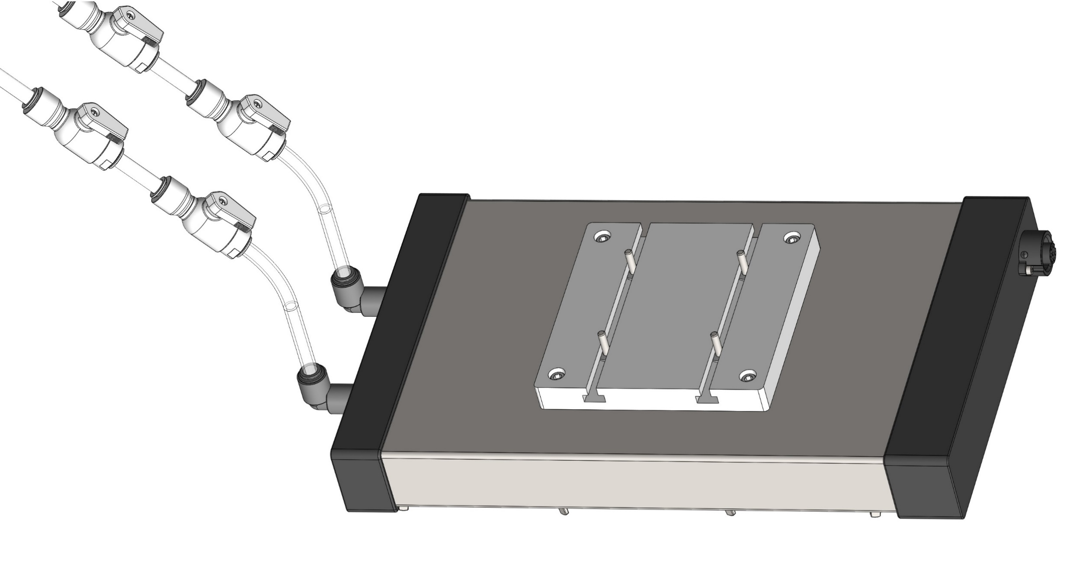
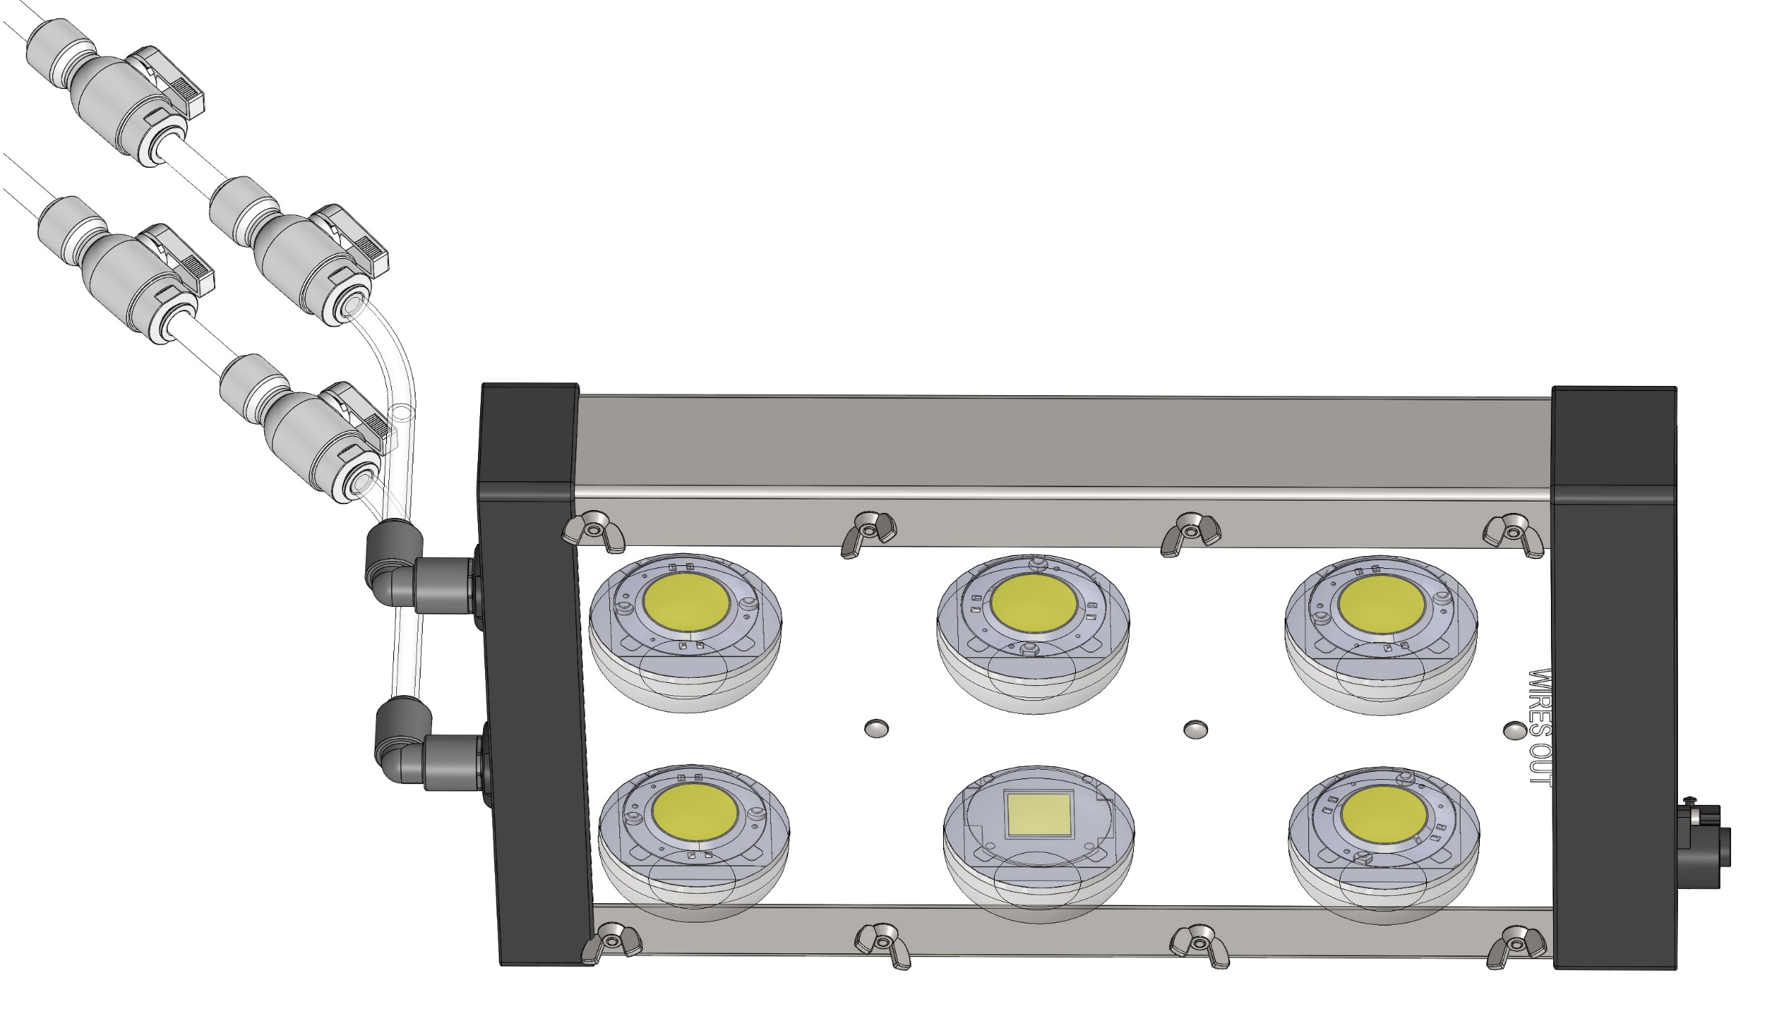
Slip the top and bottom end-caps onto the assembly.
Attach the fluidic connectors to the brass tubing, and fluidic valves to the pre-cut tubing, as shown.

